Slide 1


DoorDash Product Pitch
Automated Food Delivery with Self-Driving Cars.
Product Owner: Jamil Abdulai
© 2019 Udacity. All rights reserved.

Slide 2
Background
Why Are We Here?
The principal objective is to improve the delivery time of food to customers within a two-mile radius through automated driving robot dashers with a fundamental focus on customer satisfaction.
[Self-driving Robotic Dasher]
© 2019 Udacity. All rights reserved.

Slide 3
Business Case
© 2019 Udacity. All rights reserved.
Notes:
[ALL PARTICIPATION]

Slide 4
Initial Focus - Who are we ?
Where are we starting?
DoorDash is a technology company that connects people with the best of their neighborhoods across the US, Canada, Australia, Japan, and Germany. We enable local businesses to meet consumers’ needs of ease and convenience and in turn, generate new ways for people to earn, work, and live. By building the last-mile logistics infrastructure for local commerce, we’re fulfilling our mission to grow and empower local economies.
https://www.doordash.com/en-US/about/
© 2019 Udacity. All rights reserved.

Slide 5
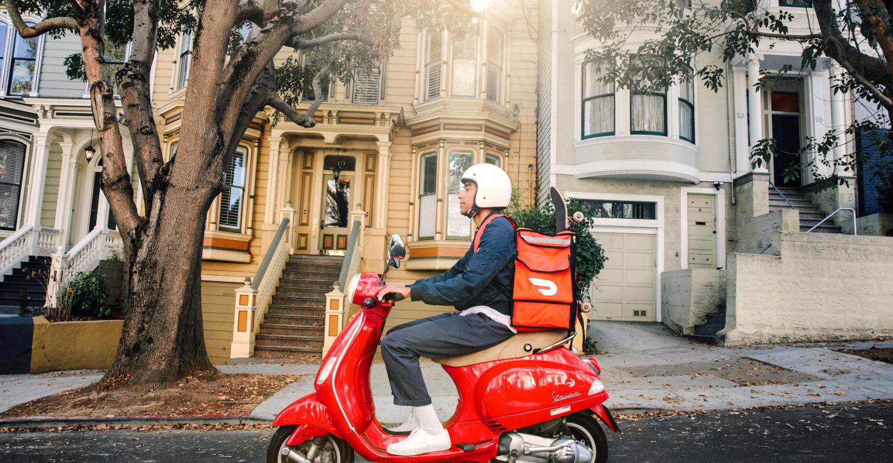
© 2019 Udacity. All rights reserved.

Slide 6
Initial Focus – Who do we serve ?
Where are we starting?
Customers: With thousands of restaurants, convenience stores, pet stores, grocery stores, and more at your fingertips, DoorDash delivers the best of your neighborhood on-demand.
Merchants: We reach new customers, stores , and grow businesses by offering delivery, pickup, and direct online ordering with DoorDash.
Dashers: Delivering with DoorDash means earning money when and how you want. Dash long term or for a goal and do it all on your own terms.
https://www.doordash.com/en-US/about/
© 2019 Udacity. All rights reserved.

Slide 7
Initial Focus – Revenue Stream
Where are we starting?
Fees
DoorDash relies on three kinds of fees, that can vary based on location and demand. They are:
Delivery Fee: $1.99 — $4.99
Small Order Fee: $2.50
Service Fee:9% — 11% of the subtotal
Catering
It is our B2B side but works just as restaurant-to-customers. The merchant only needs to sign up for accepting orders from corporate clients.
https://businessmodelanalyst.com/doordash-business-model/
© 2019 Udacity. All rights reserved.

Slide 8
Initial Focus - Revenue Stream
Where are we starting?
Commissions
DoorDash takes up some percentage of the order subtotal every time a transaction is complete on its platform. The restaurants must choose a plan:
Basic: 15% commission, with the highest delivery fees for the customer and limited delivery area;
Plus: 25% commission, with reduced delivery costs, expanded delivery area, and inclusion into the loyalty program;
Premier: 30% commission, with the lowest fees, the largest delivery area, loyalty program, and the warranty of 20 deliveries a month (otherwise it gets a fee refund).
https://businessmodelanalyst.com/doordash-business-model/
© 2019 Udacity. All rights reserved.

Slide 9
Initial Focus - Revenue Stream
Where are we starting?
Subscription
DoorDash has launched DashPass, a subscription service that offers unlimited deliveries with no delivery fees (on orders over $15) for $9.99 per month. There are more than 1.5 million subscribers nowadays.
SaaS – Software as a Service
DoorDash Storefront is software for restaurants that want to own their personalized ordering and delivery system. Merchants pay a monthly subscription to use the platform.
DashMart
DoorDash has expanded its delivery service to over 2,500 convenience stores, with some large retail players, such as CVS, Walgreens, 7-Eleven, Wawa, etc.
https://businessmodelanalyst.com/doordash-business-model/
.
© 2019 Udacity. All rights reserved.

Slide 10
Initial Focus – Revenue Stream
Where are we starting?
Brick-and-mortar store
Partnered with the San Francisco restaurant Burma Superstar, DoorDash opened Burma Bites, its first restaurant. It is a takeout and delivery operation that uses the company’s online infrastructure. Menu prices range from $2.95 to $20.
Advertising
DoorDash charges for displaying ads on its inventory. Restaurants that want to be placed at the top pay more.
https://businessmodelanalyst.com/doordash-business-model/
© 2019 Udacity. All rights reserved.

Slide 11
Initial Focus – Revenue Stream
Where are we starting?
Acquisitions
DoorDash has acquired four companies so far:
Caviar (2019): food-ordering and delivery service;
IvI5 (2019): a software company that uses computer vision to provide mapping to robots and autonomous vehicles;
Rickshaw (2017): delivery network;
Scotty Labs (2019): teleoperations company focused on self-driving vehicle technology.
https://businessmodelanalyst.com/doordash-business-model/
© 2019 Udacity. All rights reserved.

Slide 12
Opportunity
There are relatively high objections raised by businesses and customers with respect to the increase in the multiple fees associated with using DoorDash.
The company has decided to introduce better strategies to curb the prices down and reduce oprational costs.
What’s the problem?
© 2019 Udacity. All rights reserved.

Slide 13
Opportunity
The average cost to deliver food with DoorDash ranges between $1.99-$5.99(average is $4) = a
Operations cost of robots per delivery is $2.00 per meal. = b
The amount saved with the robotic service = a – b = $4 – $2 = $2 = c
Number of deliveries annually is 816,000,000 = d
The percentage of order delivery with the robots will be 80% = e
Hence TAM = c x d x e = 2 x 816,000,000 x 80% = $1,305,600,000
Total Addressable Market
© 2019 Udacity. All rights reserved.

Slide 14
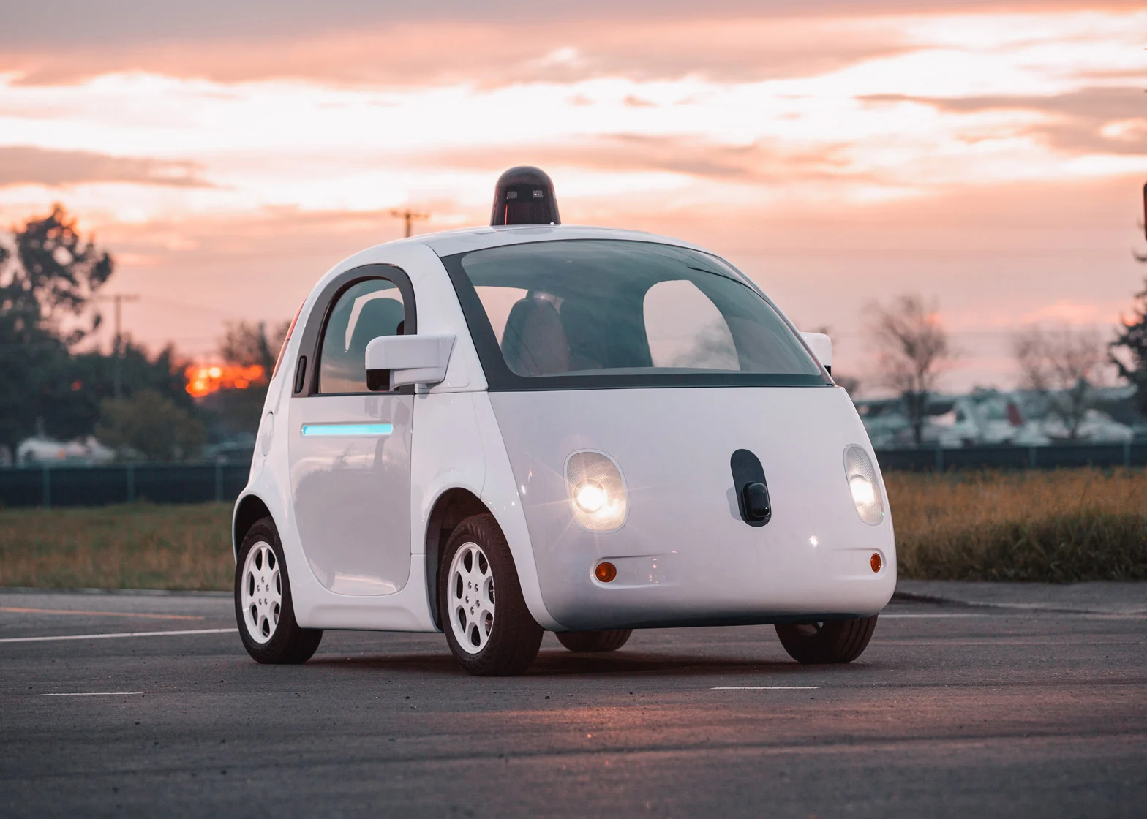
© 2019 Udacity. All rights reserved.

Slide 15
Proposal
What’s Our Solution?
The most optimum strategy to curb this roadblock will be the implementation of automated robotic dashers over human dashers for ranges within a two-mile radius.
The human dashers will prioritize deliveries over two-mile radius.
This solution will help reduce both operational costs and service fees for both the company and merchants/customers.
Also, the robots will have automated sensors to detect change in environmental factors and adjust accordingly to increase efficiency.
© 2019 Udacity. All rights reserved.

Slide 16
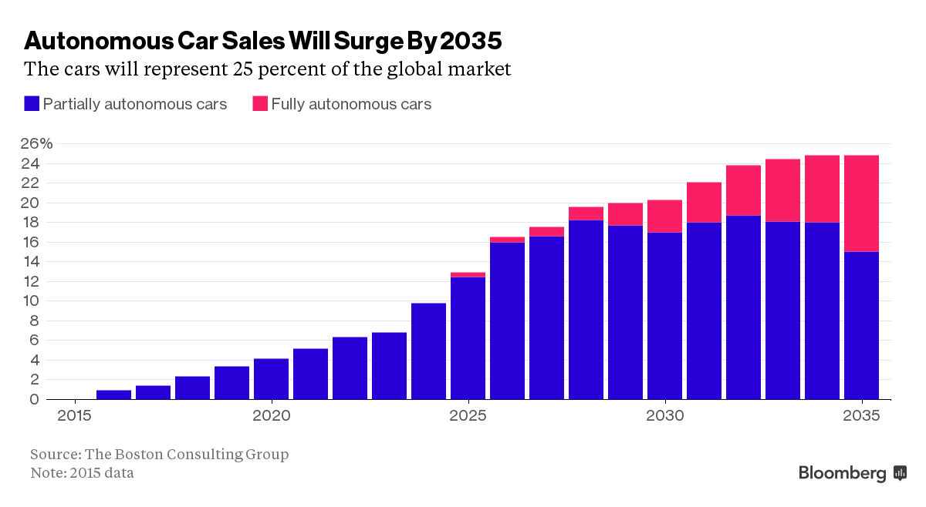
© 2019 Udacity. All rights reserved.

Slide 17
Return On Investment
What can we do?
Cost
Research and order automated driving vehicles from partner companies. The average self driving car costs $10,000.00 - $12,000.00
In-house development and maintenance of robot hardware and software.
Development of software to monitor status of deliveries remotely and remotely take control of robots that need intervention.
The development of tracking apps and map data with sidewalk details.
© 2019 Udacity. All rights reserved.

Slide 18
Return On Investment
What can we do?
Return On Investment (ROI)
The average fee paid to door dashers ranges from $2 - $10 per order(average 6) = a
Fuel Price currently is $4.07/gal = b
Operations cost of robots per delivery is $2.00 per meal = c
Number of deliveries annually is 816,000,000 = d
Cost of total investment of robotic cars and operations = $6,000,000,000.00
Net Return on investment = (a + b - c) x d = (6 + 4.07 - 2) x 816,000,000 = $ 6,585,120,000.00
ROI = (Net Return on investment /Cost of total investment of robotic cars and operations ) X 100 = (6,585,120,000.00 x $6,000,000,000.00) x 100 = 109.75%
© 2019 Udacity. All rights reserved.

Slide 19
Return On Investment
What can we do?
Reference:
https://studentloanhero.com/featured/doordash-review-real-dashers-reveal-how-much-you-can-really-earn/
https://www.spglobal.com/commodityinsights/en/market-insights/latest-news/oil/060722-oil-gasoline-prices-to-pare-gains-but-remain-high-through-2022-2023-eia
https://www.forbes.com/sites/christopherelliott/2021/08/10/food-delivery-robots-are-going-back-to-school-this-fall/?sh=35544737567a
https://backlinko.com/doordash-users#doordash-usage-statistics
© 2019 Udacity. All rights reserved.

Slide 20
Measurement
How will we know if we’re successful?
An increase in positive reviews and ratings of customers and merchants by 5% quarterly.
An increase in the number of orders by customers and merchants by 15% quarterly.
An increase in the ROI by 10% quarterly.
© 2019 Udacity. All rights reserved.

Slide 21
Third Party Partnership
Who are we collaborating with ?
We will be collaborating with Tesla. Tesla cars come standard with advanced hardware capable of providing autopilot features, and full self-driving capabilities through software updates designed to improve functionality over time.
Tesla’s autopilot AI team drives the future of autonomy of current and new generations of vehicles.
The navigation on autopilot suggests lane changes to optimize your route and adjusts so you don’t get stuck behind slow cars or trucks. When active, Navigate on Autopilot will also automatically steer your vehicle toward highway interchanges and exits based on your destination.
© 2019 Udacity. All rights reserved.

Slide 22
Third Party Partnership
Who are we collaborating with ?
Using advanced cameras, sensors and computing power, the Tesla will navigate tighter, more complex roads.
With Smart Summon, the car will navigate more complex environments and parking spaces, maneuvering around objects as necessary to come find you in a parking lot.
https://www.tesla.com/autopilot
© 2019 Udacity. All rights reserved.

Slide 23
Marketing Strategy
How will the product be marketed ?
Our main target audience will be millennials and busy workers hence the fundamental strategy will be advertisement through social media platforms such as Meta, Instagram, Snapchat and Ticktock.
Also, digital ads will be run through TVs and radios.
Lastly, we will incorporate physical ads on public transports such as busses and trains.
© 2019 Udacity. All rights reserved.

Slide 24
Competitors
© 2019 Udacity. All rights reserved.
Notes:
[ALL PARTICIPATION]

Slide 25
UberEats
Uber Eats is an online food ordering and delivery platform launched by Uber in 2014. Users can read menus, reviews and ratings, order, and pay for food from participating restaurants using an application on the iOS or Android platforms, or through a web browser. Users are also able to tip for delivery.
Delivery is rendered through humans and drones(In operational some Cities)
The company is doing well with a gross booking of 4.4B, 10.1B and 13.4B for FY19, FY20 and FY21 respectively.
https://craft.co/uber/operating-metrics
© 2019 Udacity. All rights reserved.

Slide 26
HelloFresh
HelloFresh is a food subscription company that sends pre-portioned ingredients to users’ doorstep. It offers an online platform that provides a variety of meals and recipes and enables users to order ingredients for them.
The company had a revenue of 6.0B in FY 2021 with Cost of Goods Sold at -1.9B and gross profit margin of 67%
Deliveries are primarily completed by humans.
https://craft.co/hellofresh/financials
© 2019 Udacity. All rights reserved.

Slide 27
Our Advantages
Why are we better?
DoorDash is a household name across the globe with a primary emphasis on delivering impeccable customer service.
With a clear strategy in place, DoorDash have more customers and orders, across more markets, hence they have a better data set to power their machine learning algorithms. As a result, much of the DoorDash marketplace is now driven by data.
DoorDash provides better price points to customers with high integrity and transparency as a benchmark.
DoorDash have a user-friendly app and optimum network security to reduce customer information breach.
https://larskamp.medium.com/how-doordash-built-the-most-incredible-go-to-market-playbook-ever-5e8f1d58f6cd
© 2019 Udacity. All rights reserved.

Slide 28
Our Advantages
DoorDash allow merchants to reach more customers and boost online visibility.
Our company offer convenience that customers expect and drive incremental orders.
Lastly, our company stays on top of industry trends and manage operations easier with merchant tools.
https://get.doordash.com/en-us/blog/7-advantages-of-adopting-delivery-service-for-your-restaurant
Why are we better?
© 2019 Udacity. All rights reserved.

Slide 29
Roadmap and Vision
© 2019 Udacity. All rights reserved.
Notes:
[ALL PARTICIPATION]

Slide 30
Roadmap Pillars
Where do we go from here?
FEATURE | Q1 | Q2 | Q3 | Q4
Robot prototype development in collaboration with a member organization | Camera and sensor integration. | Routing and synchronization with the mobile app | Security and compartmentalization | In-field E2E test drive
Application development | Modified maps and paths dependent on sidewalks | Enhanced route recalculations | SMS delivery and code creation | In-field E2E test drive
© 2019 Udacity. All rights reserved.

Slide 31
Software Development
Modifications in the software Structure
The fusion of maps with sidewalks into both doordash app and the automated vehicle.
Introduction of a software interface to reignite human operation of the automated vehicle.
The development of sensor and camera feed data algorithm fusion software.
Machine learning and natural language processing algorithm integration to detect and differentiate objects in surroundings.
Integration of navigation software to facilitate routes and rerouting.
Security software for robots that manages credentials, sends Message, and identifies burglary.
© 2019 Udacity. All rights reserved.

Slide 32
Hardware Development
Integration of Hardware Features.
Camera and sensor experimental development through mechanical installations and fusion with embedded software solutions.
Running a street test with multiple dimensional precisions such as adverse weather conditions, bumpy or damaged roads, and simulations of theft scenarios
© 2019 Udacity. All rights reserved.

Slide 33
Where do we go from here?
Widening the scope
The next objective will be the coupling of RADAR and LIDAR detectors for improved traffic accident and image recognition algorithms .
Also, we will be adamant to stretch the scope of delivery from 2 to 4-mile radius with emphasis on building on reliability of automated delivery irrespective of the distance.
Strategically marketing the product through logos and communication as it deliver products to merchants and customers.
Build upon the interaction communications with merchants and customers by understanding all the necessary requirements to and from.
The ability to incorporate the ideas and test across the country.
© 2019 Udacity. All rights reserved.

